Slide 1

Pandas 2, Polars or Dask?
PyData London 2023 Talk
@IanOzsvald – ianozsvald.com
@GilesWeaver – ???

Slide 2
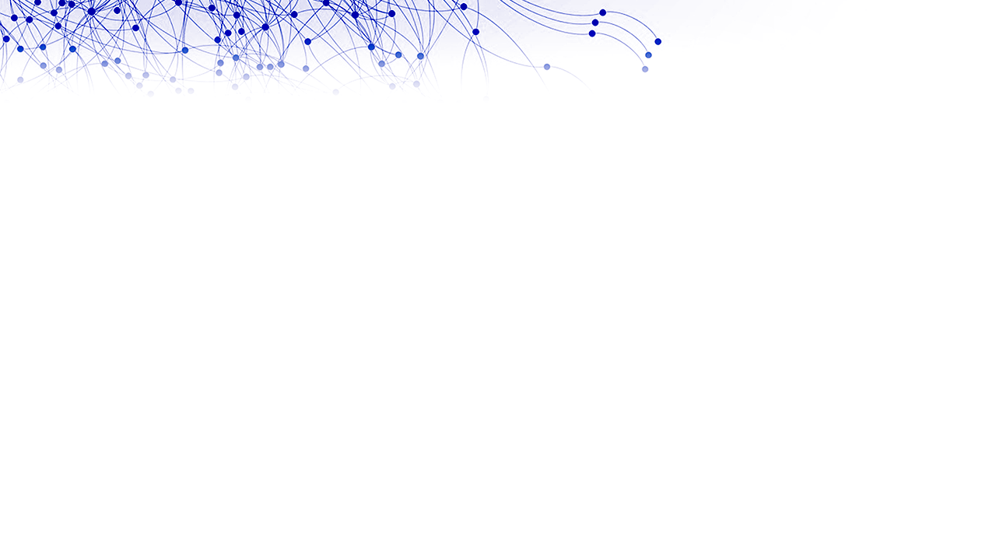
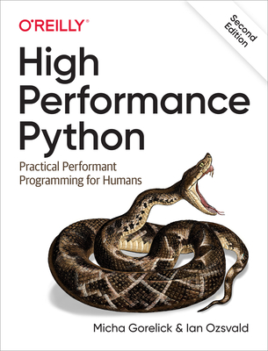



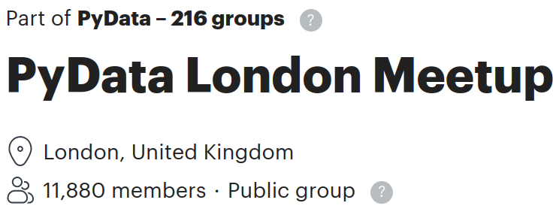


We are Ian Ozsvald & Giles Weaver
Interim Chief Data Scientist
Senior Data Scientist
2nd Edition!
By [ian]@ianozsvald[.com]

Slide 3
3 interesting DataFrame libraries
Lots of change in the ecosystem in recent years
Which library should you use? “Pandas forever”?
We benchmark. All benchmarks are lies
By [ian]@ianozsvald[.com]

Slide 4
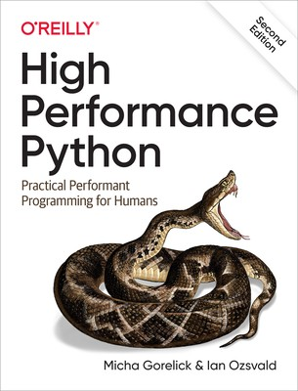
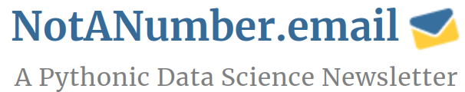
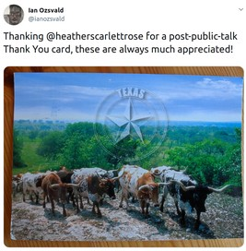
Summary
Think about your wider needs
See blog for past talks
I love receiving postcards (email me)
Join after for our discussion
By [ian]@ianozsvald[.com]

